Slide 1
CPR E 281: Digital Logic
Md Maruf Ahamed
Office: 307 Durham Center
Phone: (515) 294-6323
Email: maruf@iastate.edu

Slide 2
14–Signed Numbers
  Unsigned and Signed number representation
  1’s complement
  Example of 1’s complement addition
  2’s complement
  Example of 2’s complement addition
  Example of 2’s complement subtraction
  Design Adder/subtractor unit
  Arithmetic Overflow
  Detecting Overflow

Slide 3
Administrative Stuff
  Homework: HW#04 due on Sunday @ 11:59 PM
  Quiz: Quiz #4 due on Friday @ 4:25 PM
  Recitation: Recitation #05 this week
  Lab: Lab # 05 this week
      Submit pre-lab prior to the lab otherwise you will lose 20% points
  Lecture-15 Readings: Section 3.4, and 3.5

Slide 4
Signed Numbers
Readings 3.3

Slide 5
Formats for representation of integers
b
n
–
1
b
1
b
0
Magnitude
MSB
(a) Unsigned number
b
n
–
1
b
n
–
2
b
1
b
0
Sign
Magnitude
0 denotes
+
1 denotes
–
MSB
(b) Signed number
[ Figure 3.7 from the textbook ]

Slide 6
Formats for representing Negative Numbers
Negative numbers can be represented in following ways:
Sign and magnitude
1’s complement
2’s complement

Slide 7
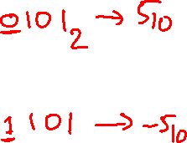
Sign and magnitude
The sign symbol distinguishes a number as being positive or negative.
Decimal Number
+ 5₁₀
− 5₁₀

Slide 8
Sign and magnitude
The sign symbol distinguishes a number as being positive or negative.
four-bit binary numbers
+ 5₁₀ = 0101
− 5₁₀ = 1101

Slide 9
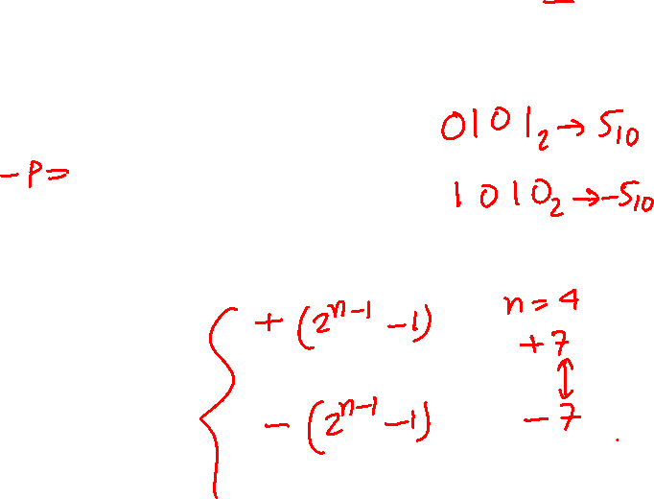
1’s complement (subtract each digit from 1)
Let K be the negative equivalent of an n-bit positive number P.
Then, in 1’s complement representation K is obtained by subtracting P from 2^{n} – 1, namely
K = (2^{n} – 1) – P
This means that K can be obtained by inverting all bits of P.

Slide 10
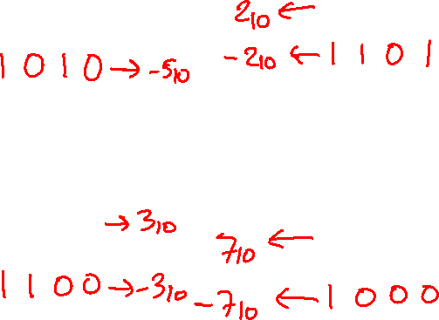
Find the 1’s complement of …
0 1 0 1
0 0 1 0
0 0 1 1
0 1 1 1

Slide 11
Find the 1’s complement of …
0 1 0 1
0 0 1 0
1 0 1 0
1 1 0 1
0 0 1 1
0 1 1 1
1 1 0 0
1 0 0 0
Just flip 1's to 0's and vice versa.

Slide 12
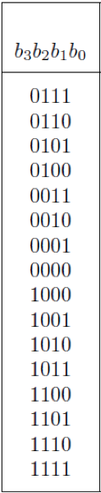
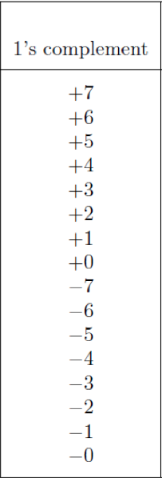

A) Example of 1’s complement addition
[ Figure 3.8 from the textbook ]
Interpretation of four-bit signed integers

Slide 13
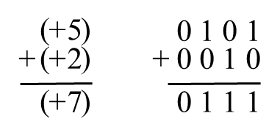

A) Example of 1’s complement addition
[ Figure 3.8 from the textbook ]
Interpretation of four-bit signed integers

Slide 14
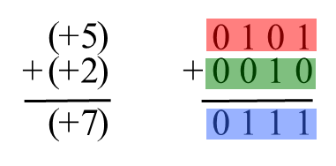
A) Example of 1’s complement addition

Slide 15
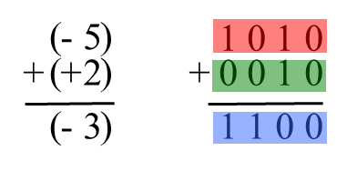
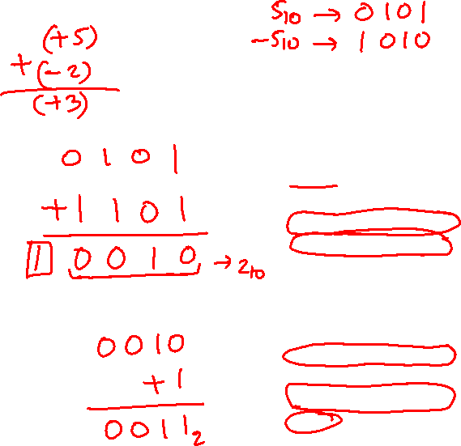
B) Example of 1’s complement addition
[ Figure 3.8 from the textbook ]

Slide 16
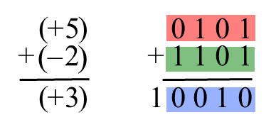
B) Example of 1’s complement addition
But this is +2!
[ Figure 3.8 from the textbook ]

Slide 17
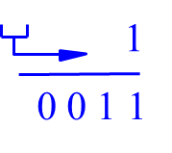
B) Example of 1’s complement addition
[ Figure 3.8 from the textbook ]

Slide 18
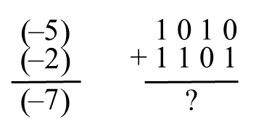
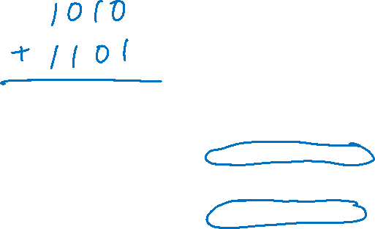
D) Example of 1’s complement addition
[ Figure 3.8 from the textbook ]

Slide 19
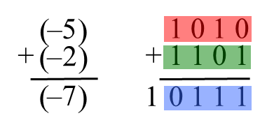

D) Example of 1’s complement addition

Slide 20
D) Example of 1’s complement addition
But this is +7!

Slide 21
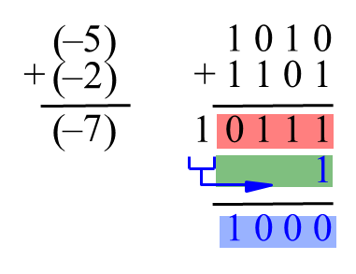

D) Example of 1’s complement addition
We need to perform one
more addition to get the result.

Slide 22
1’s complement addition-Summary
If there is a carry-out, it will be added to the least significant bit.
In some cases a correction is needed, which amounts to an extra addition that must be performed.
Consequently, the time needed to add two 1’s complement numbers may be twice as long as the time needed to add two unsigned numbers.

Slide 23
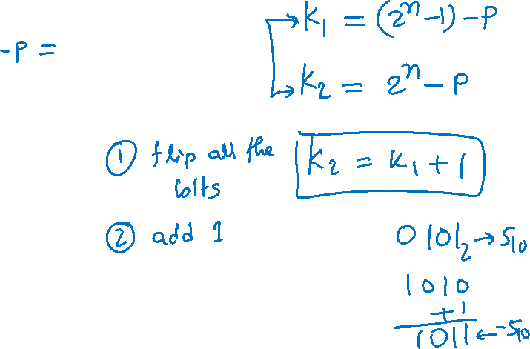
2’s complement
Let K be the negative equivalent of an n-bit positive number P.
Then, in 2’s complement representation K is obtained by subtracting P from 2^{n} , namely
K = 2^{n} – P

Slide 24
Deriving 2’s complement
For a positive n-bit number P, let K₁ and K₂ denote its 1’s and 2’s complements, respectively.
K₁ = (2^{n} – 1) – P
K₂ = 2^{n} – P
Since K₂ = K₁ + 1, it is evident that in a logic circuit the 2’s complement can computed by inverting all bits of P and then adding 1 to the resulting 1’s-complement number.

Slide 25
Find the 2’s complement of …
0 1 0 1
0 0 1 0
0 1 0 0
0 1 1 1

Slide 26
Find the 2’s complement of …
0 1 0 1
0 0 1 0
1 0 1 0
1 1 0 1
0 1 0 0
0 1 1 1
1 0 1 1
1 0 0 0
Invert all bits.

Slide 27
Find the 2’s complement of …
0 1 0 1
0 0 1 0
1 0 1 0
1 1 0 1
+
+
1
1
1 0 1 1
1 1 1 0
0 1 0 0
0 1 1 1
1 0 1 1
1 0 0 0
+
+
1
1
1 1 0 0
1 0 0 1
Then add 1.

Slide 28
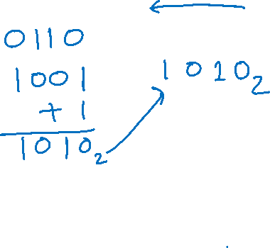
Quick Way to find 2’s complement
Scan the binary number from right to left
Copy all bits that are 0 from right to left
Stop at the first 1
Copy that 1 as well
Invert all remaining bits
0 1 1 0

Slide 29
Find the 2’s complement of …
0 1 0 1
0 0 1 0
0 1 0 0
0 1 1 1

Slide 30
Find the 2’s complement of …
0 1 0 1
0 0 1 0
. . . .
. . . 0
0 1 0 0
0 1 1 1
. . 0 0
. . . .
Copy all bits that are 0 from right to left.

Slide 31
Find the 2’s complement of …
0 1 0 1
0 0 1 0
. . . 1
. . 1 0
0 1 0 0
0 1 1 1
. 1 0 0
. . . 1
Stop at the first 1. Copy that 1 as well.

Slide 32
Find the 2’s complement of …
0 1 0 1
0 0 1 0
1 0 1 1
1 1 1 0
0 1 0 0
0 1 1 1
1 1 0 0
1 0 0 1
Invert all remaining bits.

Slide 33
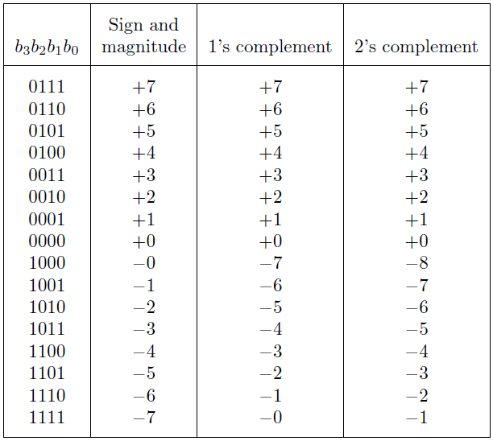
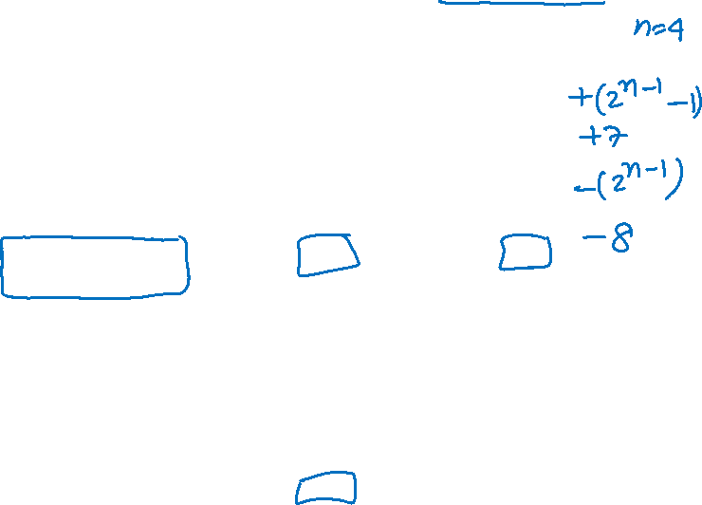
Interpretation of four-bit signed integers
[ Table 3.2 from the textbook ]

Slide 34
Interpretation of four-bit signed integers
The top half is the same in all three representations.
It corresponds to the positive integers.

Slide 35
Interpretation of four-bit signed integers
In all three representations the first bit represents the sign.
If that bit is 1, then the number is negative.

Slide 36
Interpretation of four-bit signed integers
Notice that in this representation there are two zeros!

Slide 37
Interpretation of four-bit signed integers
There are two zeros in this representation as well!

Slide 38
Interpretation of four-bit signed integers
2’s complement
Largest negative number = −2^{n−1}
Largest positive number = 2^{n−1} -1
In this representation there is one more negative number.

Slide 39
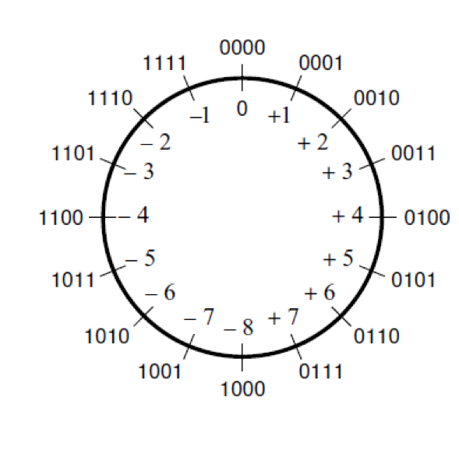
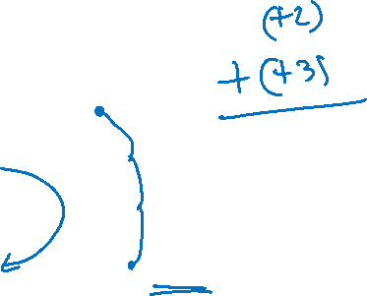
The number circle for 2's complement
Fig: Graphical interpretation of four-bit 2’s complement numbers.
The addition operation is done by stepping in the clockwise direction by the magnitude of the number to be added.
[ Figure 3.11a from the textbook ]

Slide 40
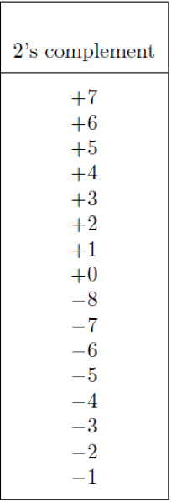
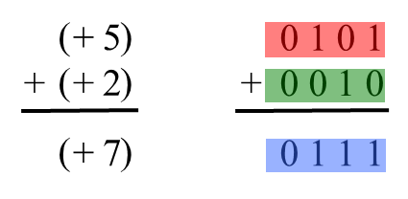

A) Example of 2’s complement addition
[ Figure 3.9 from the textbook ]

Slide 41
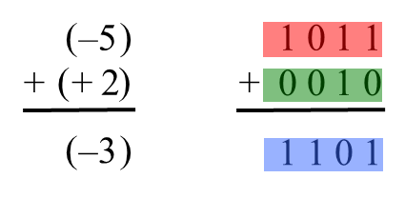
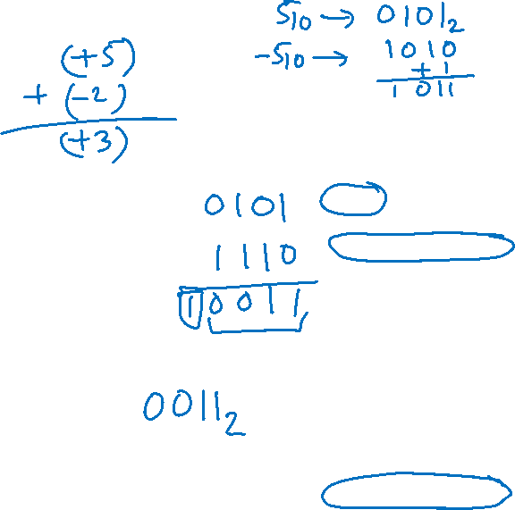
B) Example of 2’s complement addition
[ Figure 3.9 from the textbook ]

Slide 42
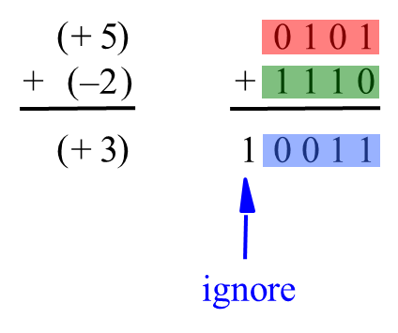
C) Example of 2’s complement addition
[ Figure 3.9 from the textbook ]

Slide 43
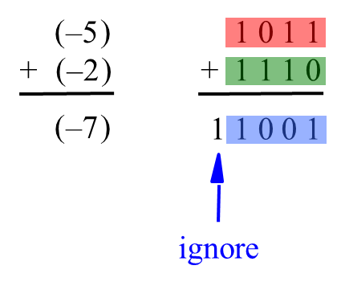
D) Example of 2’s complement addition
[ Figure 3.9 from the textbook ]

Slide 44
2's Complement Summary
When the numbers are added, the result is always correct. If there is a carry-out from the sign-bit position, it is simply ignored.
Therefore, the addition process is the same, regardless of the signs of the operands.

Slide 45
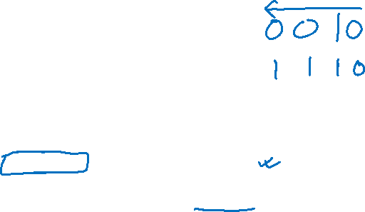
Example of 2’s complement subtraction
(
+
)
5
0 1 0 1
0 1 0 1
–
(
+
)
2
–
0 0 1 0
+
1 1 1 0
(
+
)
3
1
0 0 1 1
ignore
means take the 2's complement
[ Figure 3.10 from the textbook ]

Slide 46
Example of 2’s complement subtraction
(
)
+
5
0 1 0 1
0 1 0 1
–
(
)
+
2
–
0 0 1 0
+
1 1 1 0
(
)
+
3
1
0 0 1 1
ignore
Notice that the minus changes to a plus.
means take the 2's complement
[ Figure 3.10 from the textbook ]

Slide 47
Example of 2’s complement subtraction
(
)
+
5
0 1 0 1
0 1 0 1
–
(
)
+
2
–
0 0 1 0
+
1 1 1 0
(
)
+
3
1
0 0 1 1
ignore
[ Figure 3.10 from the textbook ]

Slide 48
Example of 2’s complement subtraction
(
)
+
5
0 1 0 1
0 1 0 1
–
(
)
+
2
–
0 0 1 0
+
1 1 1 0
(
)
+
3
1
0 0 1 1
ignore
[ Figure 3.10 from the textbook ]

Slide 49
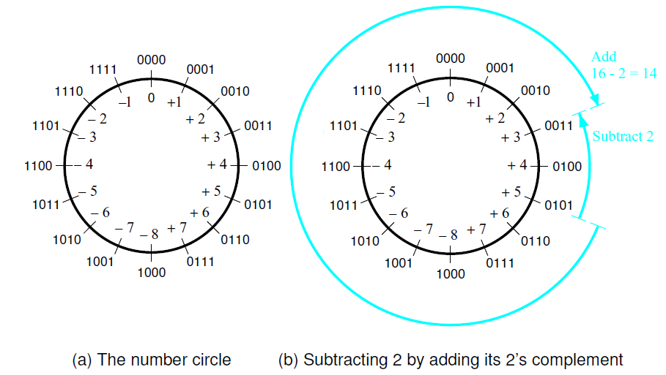
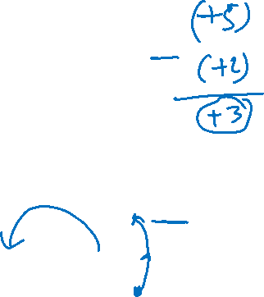
Graphical interpretation of four-bit
2’s complement numbers
[ Figure 3.11 from the textbook ]

Slide 50

Example of 2’s complement subtraction
(
)
1 0 1 1
1 0 1 1
–
5
(
)
–
+
2
–
0 0 1 0
+
1 1 1 0
(
)
1
1 0 0 1
–
7
ignore
[ Figure 3.10 from the textbook ]

Slide 51
Example of 2’s complement subtraction
(
)
+
5
0 1 0 1
0 1 0 1
–
(
)
–
+
–
2
1 1 1 0
0 0 1 0
(
)
+
7
0 1 1 1
[ Figure 3.10 from the textbook ]

Slide 52
Example of 2’s complement subtraction
(
)
1 0 1 1
1 0 1 1
–
5
–
(
)
–
+
–
2
1 1 1 0
0 0 1 0
(
)
1 1 0 1
–
3
[ Figure 3.10 from the textbook ]

Slide 53
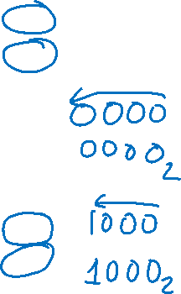
Taking the 2’s complement negates the number
decimal | b₃ b₂ b₁ b₀ | take the 2's complement | b₃ b₂ b₁ b₀ | decimal
+7 | 0111 |  | 1001 | -7
+6 | 0110 |  | 1010 | -6
+5 | 0101 |  | 1011 | -5
+4 | 0100 |  | 1100 | -4
+3 | 0011 |  | 1101 | -3
+2 | 0010 |  | 1110 | -2
+1 | 0001 |  | 1111 | -1
+0 | 0000 |  | 0000 | +0
-8 | 1000 |  | 1000 | -8
-7 | 1001 |  | 0111 | +7
-6 | 1010 |  | 0110 | +6
-5 | 1011 |  | 0101 | +5
-4 | 1100 |  | 0100 | +4
-3 | 1101 |  | 0011 | +3
-2 | 1110 |  | 0010 | +2
-1 | 1111 |  | 0001 | +1

Slide 54
Taking the 2’s complement negates the number
decimal | b₃ b₂ b₁ b₀ | take the 2's complement | b₃ b₂ b₁ b₀ | decimal
+7 | 0111 |  | 1001 | -7
+6 | 0110 |  | 1010 | -6
+5 | 0101 |  | 1011 | -5
+4 | 0100 |  | 1100 | -4
+3 | 0011 |  | 1101 | -3
+2 | 0010 |  | 1110 | -2
+1 | 0001 |  | 1111 | -1
+0 | 0000 |  | 0000 | +0
-8 | 1000 |  | 1000 | -8
-7 | 1001 |  | 0111 | +7
-6 | 1010 |  | 0110 | +6
-5 | 1011 |  | 0101 | +5
-4 | 1100 |  | 0100 | +4
-3 | 1101 |  | 0011 | +3
-2 | 1110 |  | 0010 | +2
-1 | 1111 |  | 0001 | +1
This is
the only
exception

Slide 55
Taking the 2’s complement negates the number
decimal | b₃ b₂ b₁ b₀ | take the 2's complement | b₃ b₂ b₁ b₀ | decimal
+7 | 0111 |  | 1001 | -7
+6 | 0110 |  | 1010 | -6
+5 | 0101 |  | 1011 | -5
+4 | 0100 |  | 1100 | -4
+3 | 0011 |  | 1101 | -3
+2 | 0010 |  | 1110 | -2
+1 | 0001 |  | 1111 | -1
+0 | 0000 |  | 0000 | +0
-8 | 1000 |  | 1000 | -8
-7 | 1001 |  | 0111 | +7
-6 | 1010 |  | 0110 | +6
-5 | 1011 |  | 0101 | +5
-4 | 1100 |  | 0100 | +4
-3 | 1101 |  | 0011 | +3
-2 | 1110 |  | 0010 | +2
-1 | 1111 |  | 0001 | +1
And this
one too.

Slide 56
But that exception does not matter
(
–
5
)
–
(
–
8
)
(
+
)
3

Slide 57

But that exception does not matter
(
)
1 0 1 1
1 0 1 1
–
5
–
(
)
–
+
–
8
1 0 0 0
1 0 0 0
(
)
1 0 0 1 1
+
3
ignore

Slide 58
But that exception does not matter
Add 8

Slide 59
But that exception does not matter
Subtract 8

Slide 60
Take-Home Message
Subtraction can be performed by simply adding the 2’s complement of the second number, regardless of the signs of the two numbers.
Thus, the same adder circuit can be used to perform both addition and subtraction !!!

Slide 61

Adder/subtractor unit
y
y
y
n
–
1
1
0
Add
⁄
Sub
control
x
x
x
n
–
1
1
0
c
n
-bit adder
c
n
0
s
s
s
n
–
1
1
0
[ Figure 3.12 from the textbook ]

Slide 62
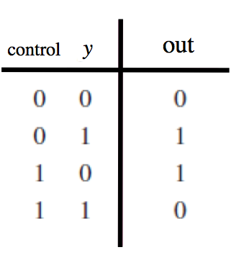

XOR Tricks
control
out
y

Slide 63
XOR as a repeater
0
y
y

Slide 64
XOR as an inverter
1
y
y

Slide 65

Adder/subtractor unit
x
x
x
y
y
y
n –
1
1
0
n
1
0
–
1
c
c
n
0
s
s
s
n
–
1
1
0

Slide 66
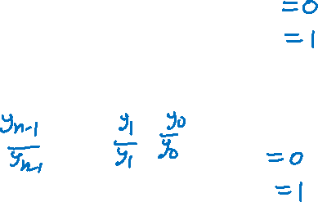
Addition: when control = 0
y
y
y
n
–
1
1
0
Add
⁄
Sub
control
x
x
x
n
–
1
1
0
c
n
-bit adder
c
n
0
s
s
s
n
–
1
1
0
[ Figure 3.12 from the textbook ]

Slide 67
Addition: when control = 0
y
y
y
0
n
–
1
1
0
Add
⁄
Sub
0
0
0
control
x
x
x
n
–
1
1
0
c
n
-bit adder
c
n
0
s
s
s
n
–
1
1
0
[ Figure 3.12 from the textbook ]

Slide 68
Addition: when control = 0
y
y
y
0
n
–
1
1
0
Add
⁄
Sub
0
0
0
control
x
x
x
n
–
1
1
0
y_{n-1}
…
y₁
y₀
c
n
-bit adder
c
n
0
s
s
s
n
–
1
1
0
[ Figure 3.12 from the textbook ]

Slide 69
Subtraction: when control = 1
y
y
y
n
–
1
1
0
Add
⁄
Sub
control
x
x
x
n
–
1
1
0
c
n
-bit adder
c
n
0
s
s
s
n
–
1
1
0
[ Figure 3.12 from the textbook ]

Slide 70
Subtraction: when control = 1
y
y
y
1
n
–
1
1
0
Add
⁄
Sub
1
1
1
control
x
x
x
n
–
1
1
0
c
n
-bit adder
c
n
0
s
s
s
n
–
1
1
0
[ Figure 3.12 from the textbook ]

Slide 71
Subtraction: when control = 1
y
y
y
1
n
–
1
1
0
Add
⁄
Sub
1
1
1
control
x
x
x
n
–
1
1
0
y_{n-1}
…
y₁
y₀
c
n
-bit adder
c
n
0
s
s
s
n
–
1
1
0
[ Figure 3.12 from the textbook ]

Slide 72
Subtraction: when control = 1
y
y
y
1
n
–
1
1
0
Add
⁄
Sub
1
1
1
control
x
x
x
n
–
1
1
0
y_{n-1}
…
y₁
y₀
c
n
-bit adder
c
n
1
0
carry for the
first column!
s
s
s
n
–
1
1
0
[ Figure 3.12 from the textbook ]

Slide 73
Arithmetic Overflow
The result of addition or subtraction is supposed to fit within the significant bits used to represent the numbers.
If n bits are used to represent signed numbers, then the result must be in the range −2^{n−1} to 2^{n−1} − 1.
If the result does not fit in this range, then we say that arithmetic overflow has occurred.
When the numbers have opposite signs, there is no overflow.

Slide 74
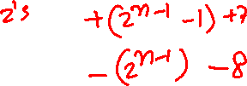
Examples of determination of overflow
(
+
7
)
0 1 1 1
(
–
7
)
1 0 0 1
(
)
+
(
)
+
+
+
2
0 0 1 0
+
+
2
0 0 1 0
(
+
9
)
1 0 0 1
(
–
5
)
1 0 1 1
(
+
7
)
+
0 1 1 1
(
–
7
)
+
1 0 0 1
+
(
–
2
)
1 1 1 0
+
(
–
2
)
1 1 1 0
(
+
5
)
1
0 1 0 1
(
–
9
)
1
0 1 1 1
[ Figure 3.13 from the textbook ]

Slide 75
Examples of determination of overflow
0 1 1 0 0
0 0 0 0 0
(
+
7
)
0 1 1 1
(
–
7
)
1 0 0 1
(
)
+
(
)
+
+
+
2
0 0 1 0
+
+
2
0 0 1 0
(
+
9
)
1 0 0 1
(
–
5
)
1 0 1 1
1 1 1 0 0
1 0 0 0 0
(
+
7
)
+
0 1 1 1
(
–
7
)
+
1 0 0 1
+
(
–
2
)
1 1 1 0
+
(
–
2
)
1 1 1 0
(
+
5
)
1
0 1 0 1
(
–
9
)
1
0 1 1 1
Include the carry bits: c₄ c₃ c₂ c₁ c₀

Slide 76
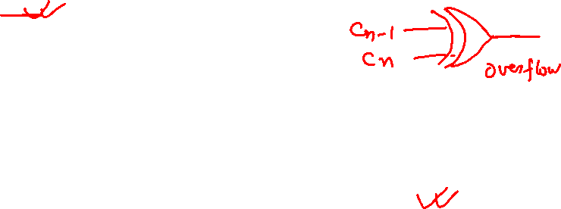
Examples of determination of overflow
0 1 1 0 0
0 0 0 0 0
(
+
7
)
0 1 1 1
(
–
7
)
1 0 0 1
(
)
+
(
)
+
+
+
2
0 0 1 0
+
+
2
0 0 1 0
(
+
9
)
1 0 0 1
(
–
5
)
1 0 1 1
1 1 1 0 0
1 0 0 0 0
(
+
7
)
+
0 1 1 1
(
–
7
)
+
1 0 0 1
+
(
–
2
)
1 1 1 0
+
(
–
2
)
1 1 1 0
(
+
5
)
1
0 1 0 1
(
–
9
)
1
0 1 1 1
Include the carry bits: c₄ c₃ c₂ c₁ c₀

Slide 77
Examples of determination of overflow
c
4
=
0
c
4
=
0
c
=
1
0 1 1 0 0
0 0 0 0 0
c
=
0
3
(
+
7
)
0 1 1 1
(
–
7
)
1 0 0 1
3
(
)
+
(
)
+
+
+
2
0 0 1 0
+
+
2
0 0 1 0
(
+
9
)
1 0 0 1
(
–
5
)
1 0 1 1
c
4
=
1
c
4
=
1
c
=
1
1 1 1 0 0
1 0 0 0 0
c
=
0
3
(
+
7
)
0 1 1 1
(
–
7
)
1 0 0 1
3
+
+
+
(
–
2
)
1 1 1 0
+
(
–
2
)
1 1 1 0
(
+
5
)
1
0 1 0 1
(
–
9
)
1
0 1 1 1
Include the carry bits: c₄ c₃ c₂ c₁ c₀

Slide 78
Examples of determination of overflow
c
4
=
0
c
4
=
0
c
=
1
0 1 1 0 0
0 0 0 0 0
c
=
0
3
(
+
7
)
0 1 1 1
(
–
7
)
1 0 0 1
3
(
)
+
(
)
+
+
+
2
0 0 1 0
+
+
2
0 0 1 0
(
+
9
)
1 0 0 1
(
–
5
)
1 0 1 1
c
4
=
1
c
4
=
1
c
=
1
1 1 1 0 0
1 0 0 0 0
c
=
0
3
(
+
7
)
0 1 1 1
(
–
7
)
1 0 0 1
3
+
+
+
(
–
2
)
1 1 1 0
+
(
–
2
)
1 1 1 0
(
+
5
)
1
0 1 0 1
(
–
9
)
1
0 1 1 1
Overflow occurs only in these two cases.

Slide 79
Examples of determination of overflow
c
4
=
0
c
4
=
0
c
=
1
0 1 1 0 0
0 0 0 0 0
c
=
0
3
(
+
7
)
0 1 1 1
(
–
7
)
1 0 0 1
3
(
)
+
(
)
+
+
+
2
0 0 1 0
+
+
2
0 0 1 0
(
+
9
)
1 0 0 1
(
–
5
)
1 0 1 1
c
4
=
1
c
4
=
1
c
=
1
1 1 1 0 0
1 0 0 0 0
c
=
0
3
(
+
7
)
0 1 1 1
(
–
7
)
1 0 0 1
3
+
+
+
(
–
2
)
1 1 1 0
+
(
–
2
)
1 1 1 0
(
+
5
)
1
0 1 0 1
(
–
9
)
1
0 1 1 1
Overflow = c₃c₄ + c₃c₄

Slide 80
Examples of determination of overflow
c
4
=
0
c
4
=
0
c
=
1
0 1 1 0 0
0 0 0 0 0
c
=
0
3
(
+
7
)
0 1 1 1
(
–
7
)
1 0 0 1
3
(
)
+
(
)
+
+
+
2
0 0 1 0
+
+
2
0 0 1 0
(
+
9
)
1 0 0 1
(
–
5
)
1 0 1 1
c
4
=
1
c
4
=
1
c
=
1
1 1 1 0 0
1 0 0 0 0
c
=
0
3
(
+
7
)
0 1 1 1
(
–
7
)
1 0 0 1
3
+
+
+
(
–
2
)
1 1 1 0
+
(
–
2
)
1 1 1 0
(
+
5
)
1
0 1 0 1
(
–
9
)
1
0 1 1 1
Overflow = c₃c₄ + c₃c₄
XOR

Slide 81
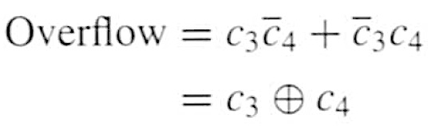
Calculating overflow for 4-bit numbers
with only three significant bits

Slide 82

Calculating overflow for n-bit numbers
with only n-1 significant bits

Slide 83
Detecting Overflow
x
y
x
y
x
y
n –
1
n
1
1
0
0
–
1
c
c
c
c
1
c
FA
n
FA
FA
n
-
1
2
0
s
s
s
n
–
1
1
0

Slide 84
Detecting Overflow
(with one extra XOR)
x
y
x
y
x
y
n –
1
n
1
1
0
0
–
1
c
c
c
c
1
c
FA
n
FA
FA
n
-
1
2
0
s
s
s
n
–
1
1
0
overflow

Slide 85
Another way to look at the overflow issue
X= x₃ x₂ x₁ x₀
Y= y₃ y₂ y₁ y₀
S= s₃ s₂ s₁ s₀
+

Slide 86
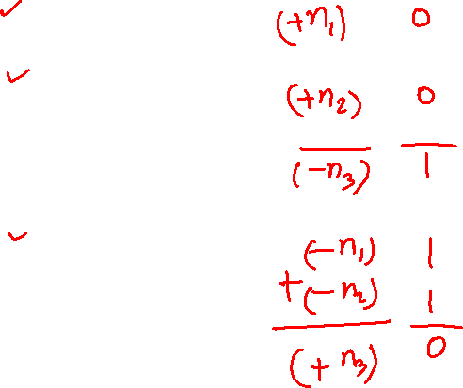
Another way to look at the overflow issue
X= x₃ x₂ x₁ x₀
Y= y₃ y₂ y₁ y₀
S= s₃ s₂ s₁ s₀
+
If both numbers that we are adding have the same sign
but the sum does not, then we have an overflow.

Slide 87
Examples of determination of overflow
(
+
7
)
0 1 1 1
(
–
7
)
1 0 0 1
(
)
+
(
)
+
+
+
2
0 0 1 0
+
+
2
0 0 1 0
(
+
9
)
1 0 0 1
(
–
5
)
1 0 1 1
(
+
7
)
+
0 1 1 1
(
–
7
)
+
1 0 0 1
+
(
–
2
)
1 1 1 0
+
(
–
2
)
1 1 1 0
(
+
5
)
1
0 1 0 1
(
–
9
)
1
0 1 1 1

Slide 88

Examples of determination of overflow
(
+
7
)
0 1 1 1
(
–
7
)
1 0 0 1
(
)
+
(
)
+
+
+
2
0 0 1 0
+
+
2
0 0 1 0
(
+
9
)
1 0 0 1
(
–
5
)
1 0 1 1
(
+
7
)
+
0 1 1 1
(
–
7
)
+
1 0 0 1
+
(
–
2
)
1 1 1 0
+
(
–
2
)
1 1 1 0
(
+
5
)
1
0 1 0 1
(
–
9
)
1
0 1 1 1

Slide 89
Examples of determination of overflow
x
3
=
0
x
3
=
1
y
3
=
0
y
3
=
0
(
+
7
)
0 1 1 1
(
–
7
)
1 0 0 1
s
=
1
(
)
+
(
)
+
s
=
1
3
+
+
2
0 0 1 0
+
+
2
0 0 1 0
3
(
+
9
)
1 0 0 1
(
–
5
)
1 0 1 1
x
3
=
0
x
3
=
1
y
3
=
1
(
+
7
)
0 1 1 1
(
–
7
)
1 0 0 1
y
3
=
1
s
=
0
+
+
s
=
0
3
+
(
–
2
)
1 1 1 0
+
(
–
2
)
1 1 1 0
3
(
+
5
)
1
0 1 0 1
(
–
9
)
1
0 1 1 1

Slide 90
Examples of determination of overflow
x
3
=
0
x
3
=
1
y
3
=
0
y
3
=
0
(
+
7
)
0 1 1 1
(
–
7
)
1 0 0 1
s
=
1
(
)
+
(
)
+
s
=
1
3
+
+
2
0 0 1 0
+
+
2
0 0 1 0
3
(
+
9
)
1 0 0 1
(
–
5
)
1 0 1 1
x
3
=
0
x
3
=
1
y
3
=
1
(
+
7
)
0 1 1 1
(
–
7
)
1 0 0 1
y
3
=
1
s
=
0
+
+
s
=
0
3
+
(
–
2
)
1 1 1 0
+
(
–
2
)
1 1 1 0
3
(
+
5
)
1
0 1 0 1
(
–
9
)
1
0 1 1 1
In 2's complement, both +9 and -9 are not representable with 4 bits.

Slide 91
Examples of determination of overflow
x
3
=
0
x
3
=
1
y
3
=
0
y
3
=
0
(
+
7
)
0 1 1 1
(
–
7
)
1 0 0 1
s
=
1
(
)
+
(
)
+
s
=
1
3
+
+
2
0 0 1 0
+
+
2
0 0 1 0
3
(
+
9
)
1 0 0 1
(
–
5
)
1 0 1 1
x
3
=
0
x
3
=
1
y
3
=
1
(
+
7
)
0 1 1 1
(
–
7
)
1 0 0 1
y
3
=
1
s
=
0
+
+
s
=
0
3
+
(
–
2
)
1 1 1 0
+
(
–
2
)
1 1 1 0
3
(
+
5
)
1
0 1 0 1
(
–
9
)
1
0 1 1 1
Overflow occurs only in these two cases.

Slide 92
Examples of determination of overflow
x
3
=
0
x
3
=
1
y
3
=
0
y
3
=
0
(
+
7
)
0 1 1 1
(
–
7
)
1 0 0 1
s
=
1
(
)
+
(
)
+
s
=
1
3
+
+
2
0 0 1 0
+
+
2
0 0 1 0
3
(
+
9
)
1 0 0 1
(
–
5
)
1 0 1 1
x
3
=
0
x
3
=
1
y
3
=
1
(
+
7
)
0 1 1 1
(
–
7
)
1 0 0 1
y
3
=
1
s
=
0
+
+
s
=
0
3
+
(
–
2
)
1 1 1 0
+
(
–
2
)
1 1 1 0
3
(
+
5
)
1
0 1 0 1
(
–
9
)
1
0 1 1 1
Overflow = x₃ y₃ s₃ + x₃ y₃ s₃

Slide 93
Another way to look at the overflow issue
X= x₃ x₂ x₁ x₀
Y= y₃ y₂ y₁ y₀
S= s₃ s₂ s₁ s₀
+
If both numbers that we are adding have the same sign
but the sum does not, then we have an overflow.
Overflow = x₃ y₃ s₃ + x₃ y₃ s₃

Slide 94
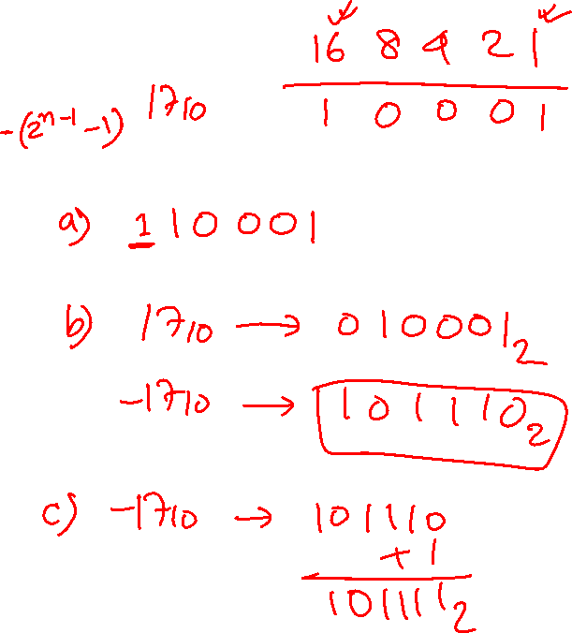
Lec 14: Test Q1
Convert -17₁₀ to binary using following:
  Sign and magnitude
  1’s complement
  2’s complement.

Slide 95
Lec 14: Test Q2
Perform the following operations in 2's complement form and identify, if there is any overflow occurs or not.
                (-13₁₀)
                + (- 4₁₀)
                -------------------------------------

Slide 96
Lec 14: Test Q2
Perform the following operations in 2's complement form and identify, if there is any overflow occurs or not.
                (-13₁₀)
                + (- 4₁₀)
                -------------------------------------

Slide 97

END Slide

